Slide 1
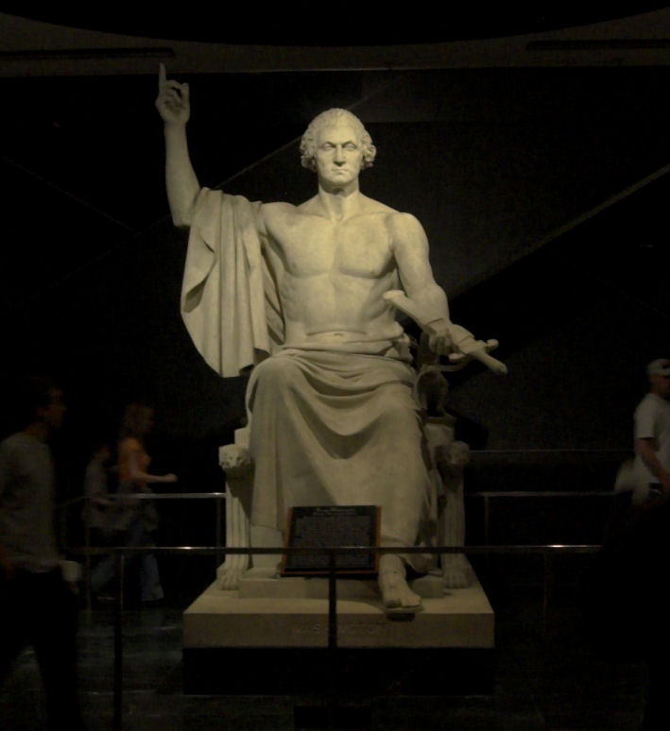
George Washington
There can only be one #1

Slide 2
Targets

Slide 3
Questions to Ponder
Economy: Discuss Hamilton's economic policy. How did it differ with Madison's? How did different regions of the country view the plan?
Foreign Policy: What was Washington's view on foreign affairs? Explain how differences concerning support for the French Revolution, foreign policy issues and immigration contributed to the emergence of an organized opposition party led by Jefferson and Madison.
Parties: Identify the major planks of both the Federalist and Republican platform. To what extent does the social and economic status of the leadership of each of the two parties reflect their membership? Who would be most likely to support the Federalists? The Republicans?

Slide 4
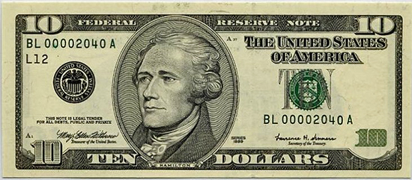
The Economy: Hamilton
Pay foreign and domestic debt at face value; repaid at 4 %
Central gov. assumes state debt (problem b/c some states (VA, MD, NC, GA) had already repaid their debts→ taxed twice to help repay other states' debts)
Development of industry: assumption and funding→ allows wealthy in state to provide capital to industry
Creation of a national bank: largely funded by the central gov. and wealthy investors; strengthen gov. trust, credit, standardize money
E. Loose interpretation; "necessary and proper"
F. Protective tariffs: not allowed
He’s on money.

Slide 5
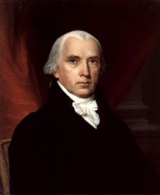
The Economy: Madison
Pay some to current owners of cert. And some to original owners→ would ruin the trust in the good faith of the US in restoring credit
Strict interpretation of Constitution
But he got to be president.

Slide 6
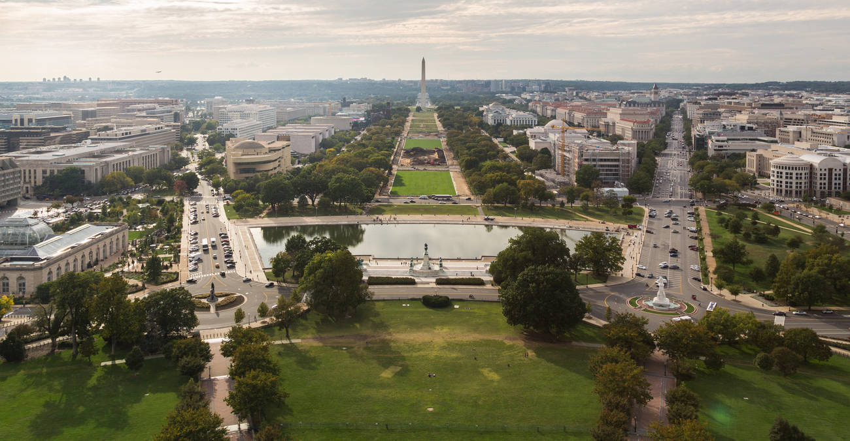
Compromise
Bill that provided both funding of national debt and assumption of state debts (VA, MD, etc.→partial payment)
Capital moved to Washington, DC

Slide 7
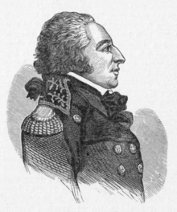
Foreign Policy
Jefferson – sides w/ France during French Revolution; treaties made w/ French nation and still binding; US shouldn’t declare neutrality but remain neutral
Hamilton – sides w/ England; wanted to scrap previous alliance w/ French (new govt., new rules), should refuse Edmond Genet (French foreign minister)
Washington proclaims neutrality to US only→
Genet overextended his duties and Washington demanded his recall
Get Out, Genet!

Slide 8
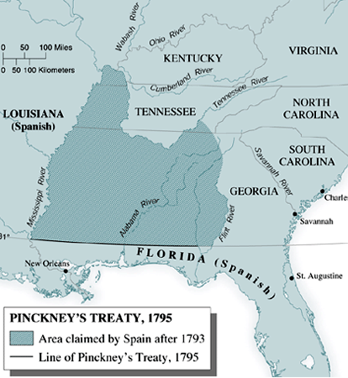
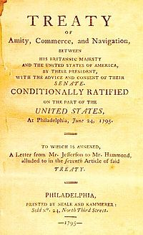
Solutions
US signs treaty with Britain in order to appease all sides (Jay's Treaty)
Britain gets rights to trade freely in American ports in exchange for withdrawing their troops from the Northwest
impressment remained unsettled
Pinckney's Treaty – US wins from Spain – free navigation of Miss. R, southern boundary at the 31st parallel, western at Miss. R

Slide 9
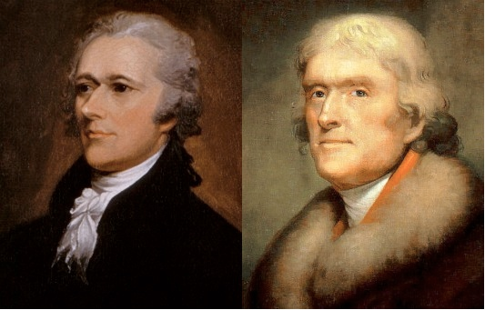
The Folly of Parties
Federalists (Hamilton; Gazette of the US –Fenno)
Democratic-Republicans (Jefferson-Madison; National Gazette – Freneau)
Democratic clubs develop natural opposition to issues→ popular support of parties that had previously existed just in politics→ imitated the Jacobin society→
Whiskey Rebellion (1794) – put down by militia sent by Washington→ Denounces democratic clubs even though rebellion not started by one
V.

Slide 10
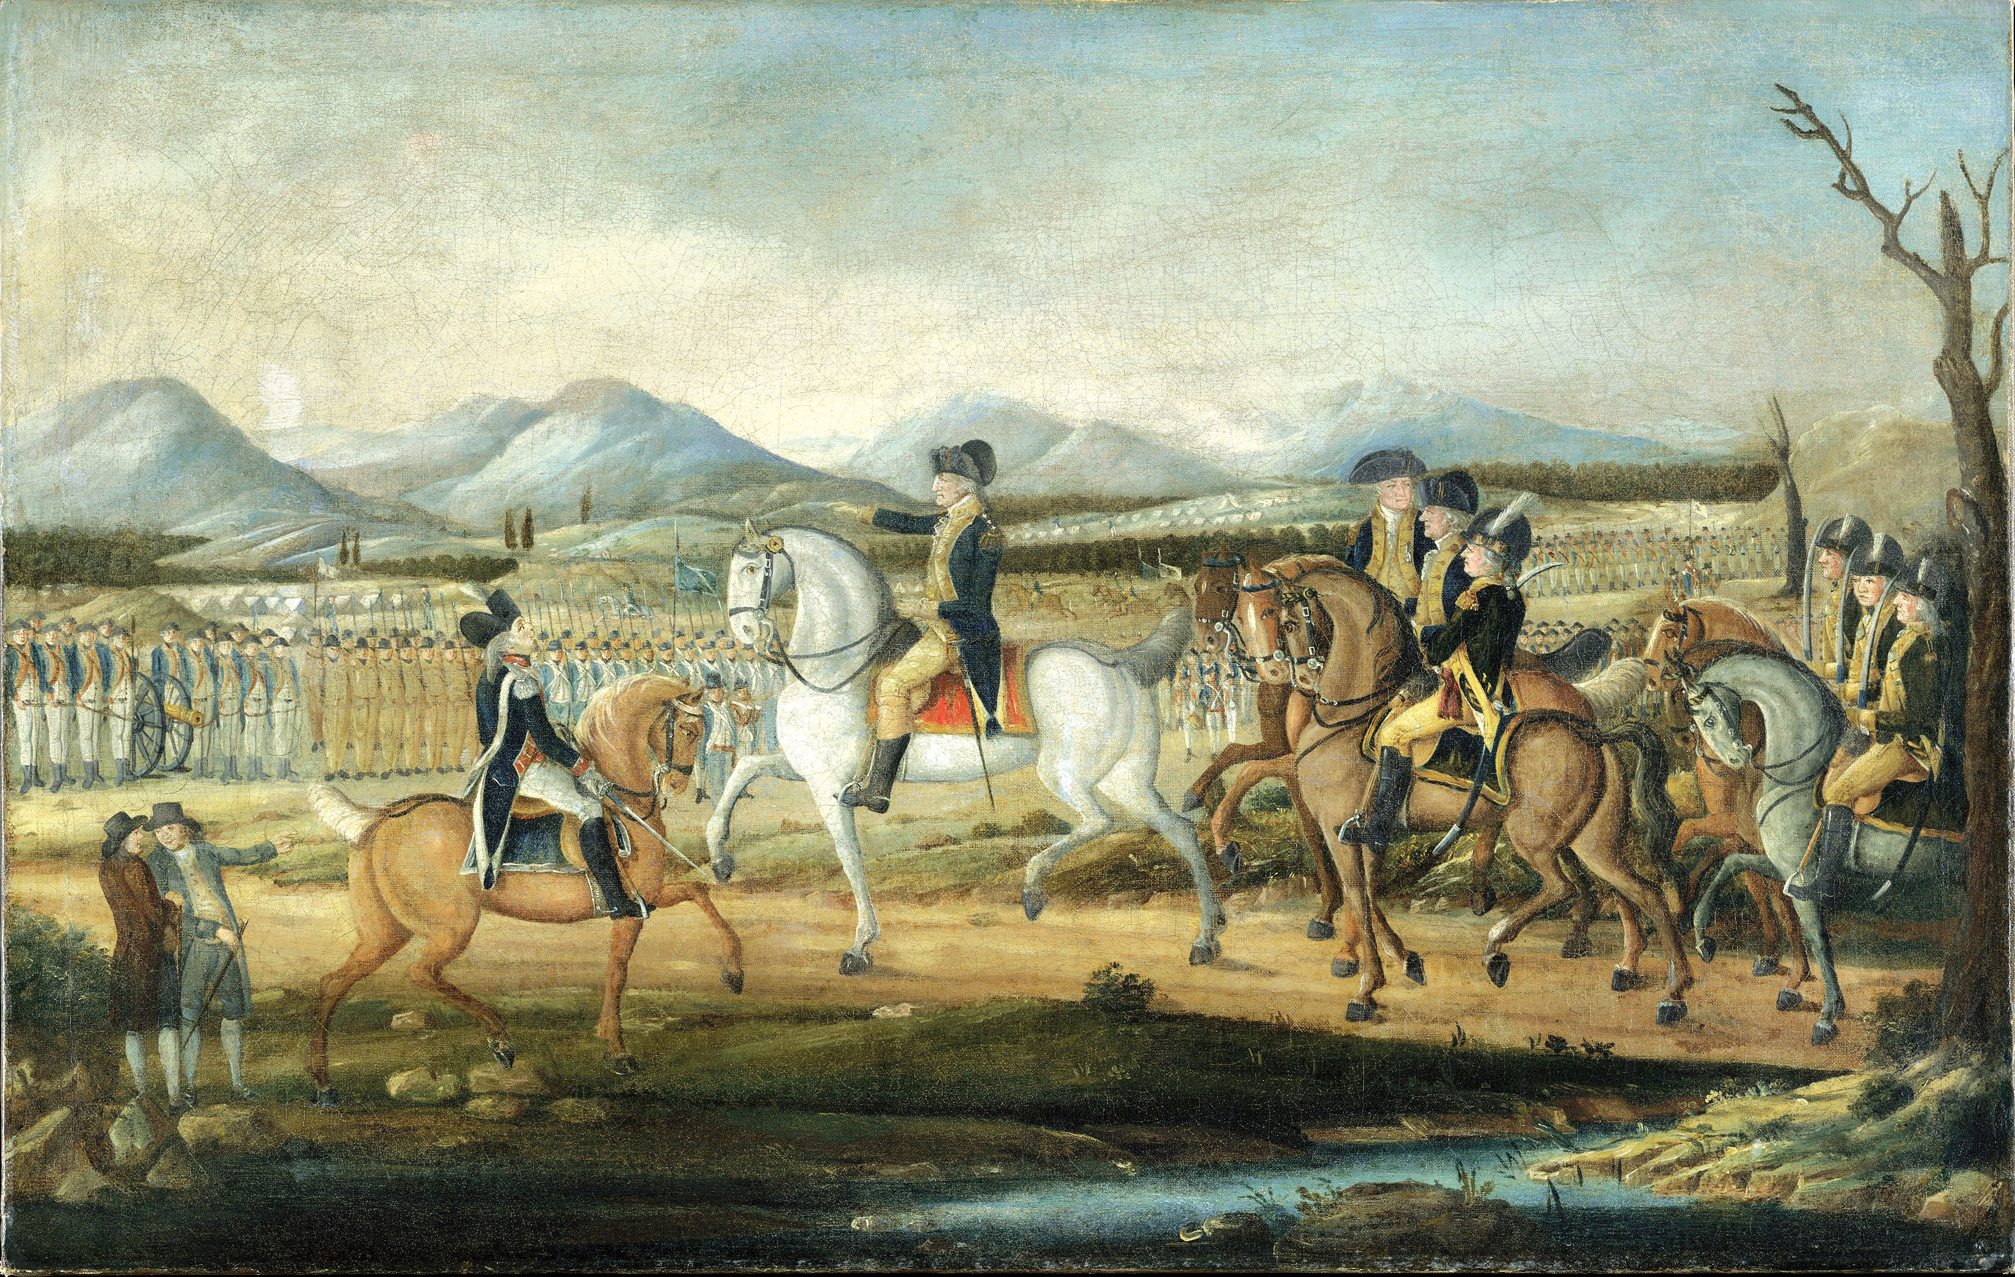
Whiskey Rebellion

